Slide 1


UTA EE LABS
Using IR to Transmit and Receive data

Slide 2
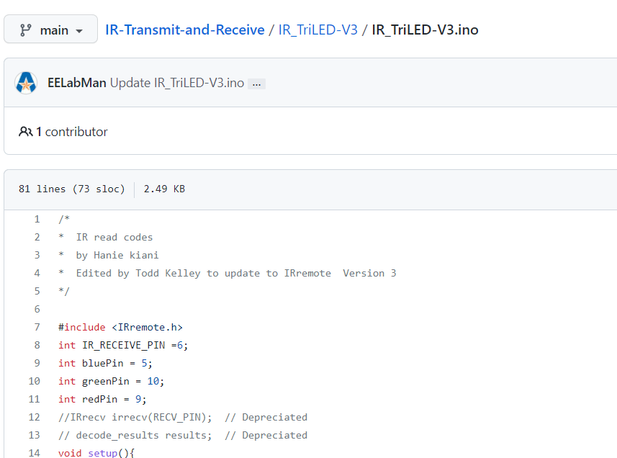
Code and PowerPoint is downloadable from GitHub
https://github.com/EELabMan
Go to Repositories -> IR-Transmit-and-Receive For PowerPoint and code

Slide 3
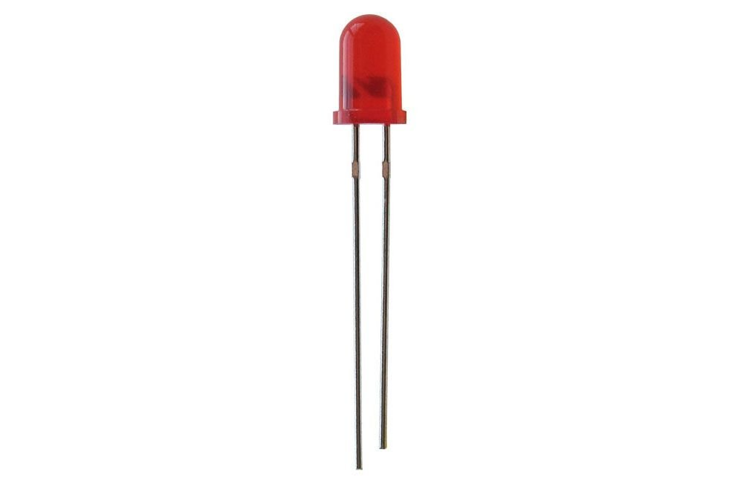
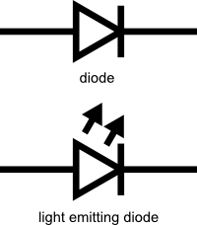
LED Basics
Common 5mm LED
The LED is a very low energy light source
Anode
Cathode
+
-

Slide 4
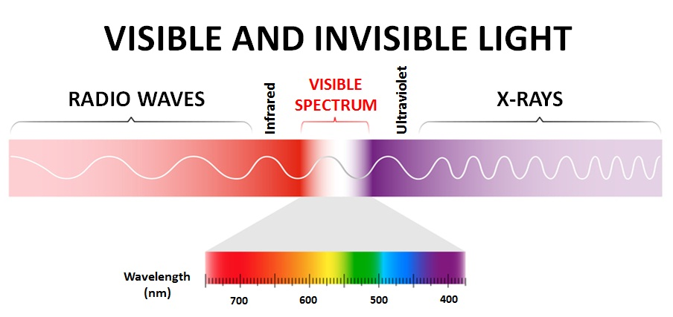
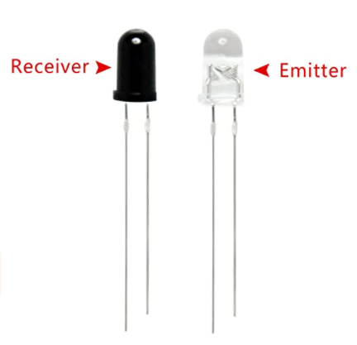
IR LED’s

Slide 5
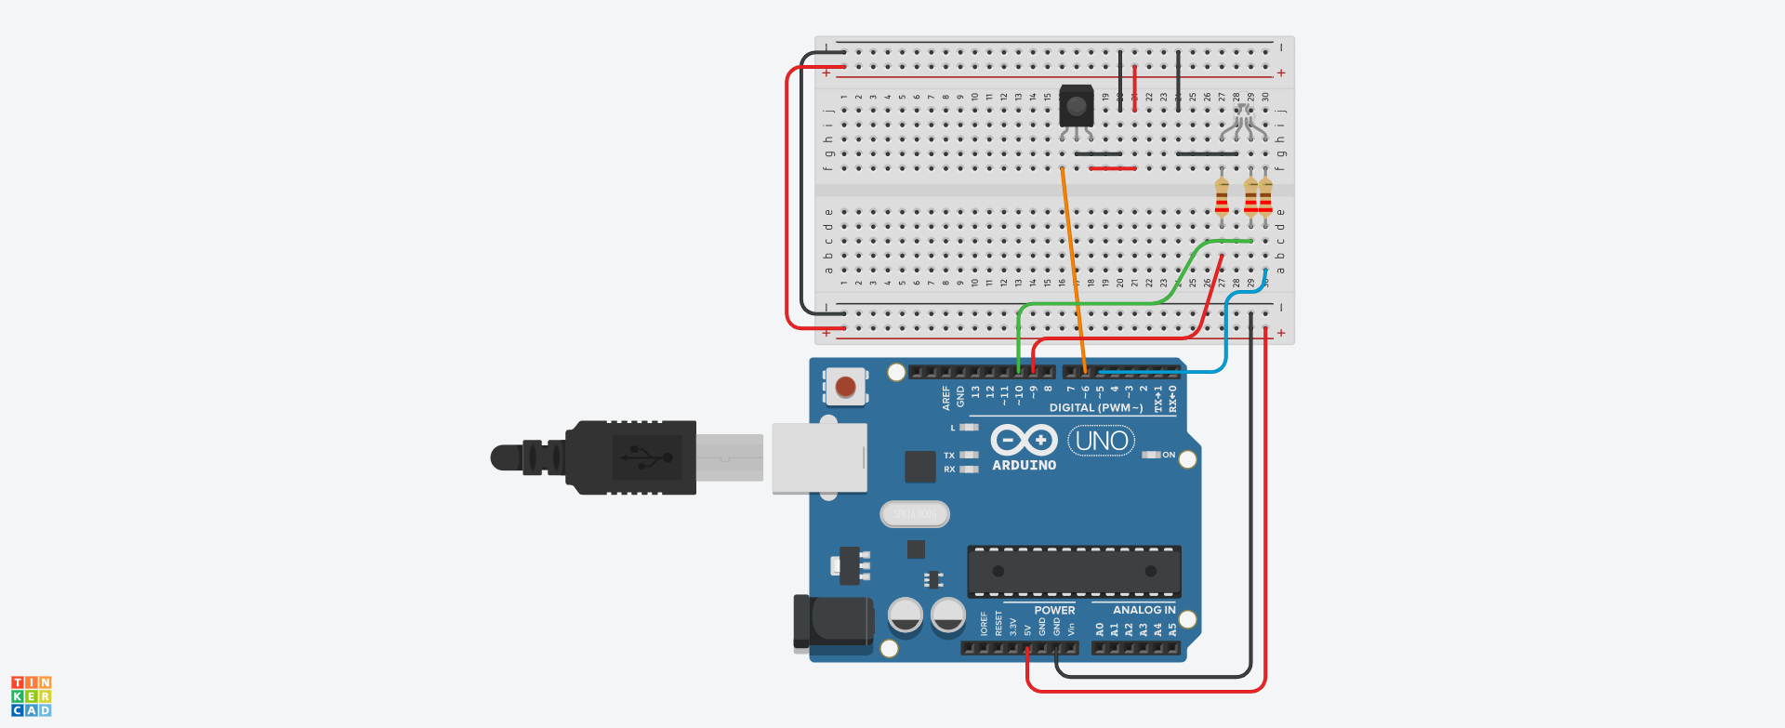
Let’s build the Receiver circuit

Slide 6
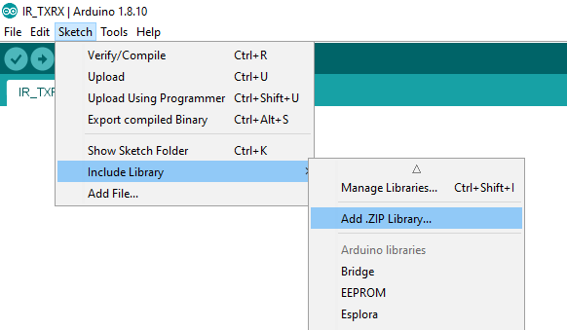
Arduino Libraries
We need to include a library to make our IR work.
Add from Sketch->Include Library-> Add .ZIP Library.
It should be one of the folders you unzipped.

Slide 7
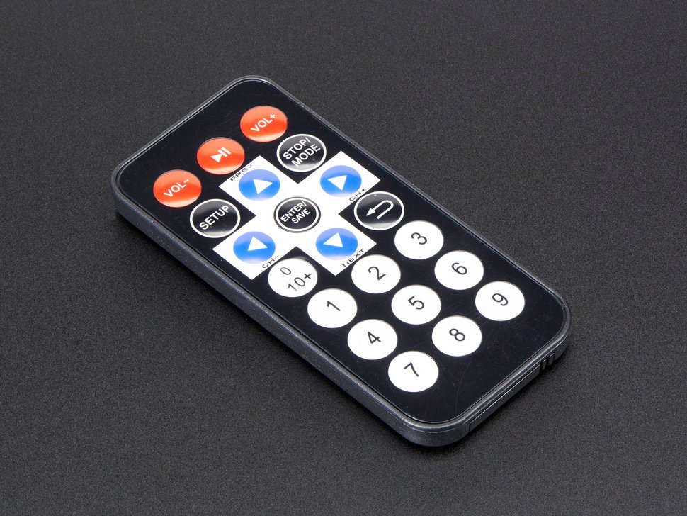
Upload the code and Test
Open the IR_TriLED-V3.ino in the Arduino IDE. It should be in the folder you unzipped.
Pressing 1 on the remote should turn on the Red LED
Pressing 2 on the remote should turn on the Green LED
Pressing 3 on the remote should turn on the Blue LED
Pressing 4-9 will have different colors
Pressing Stop/Mode will turn the LED off

Slide 8
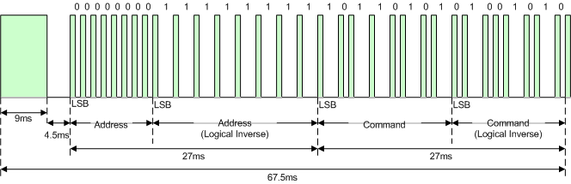
IR Transmit
Use a different Arduino Uno and Breadboard to build the TX. We will still use the IR RX Uno and breadboard. We will power it from a battery or wall wart.
Download IR_TX.ino from github and upload.
Notice it is modified from the RGB Nightlight.ino. We just send codes over IR instead of setting the RGB values.
Modulated at 38KHz.

Slide 9
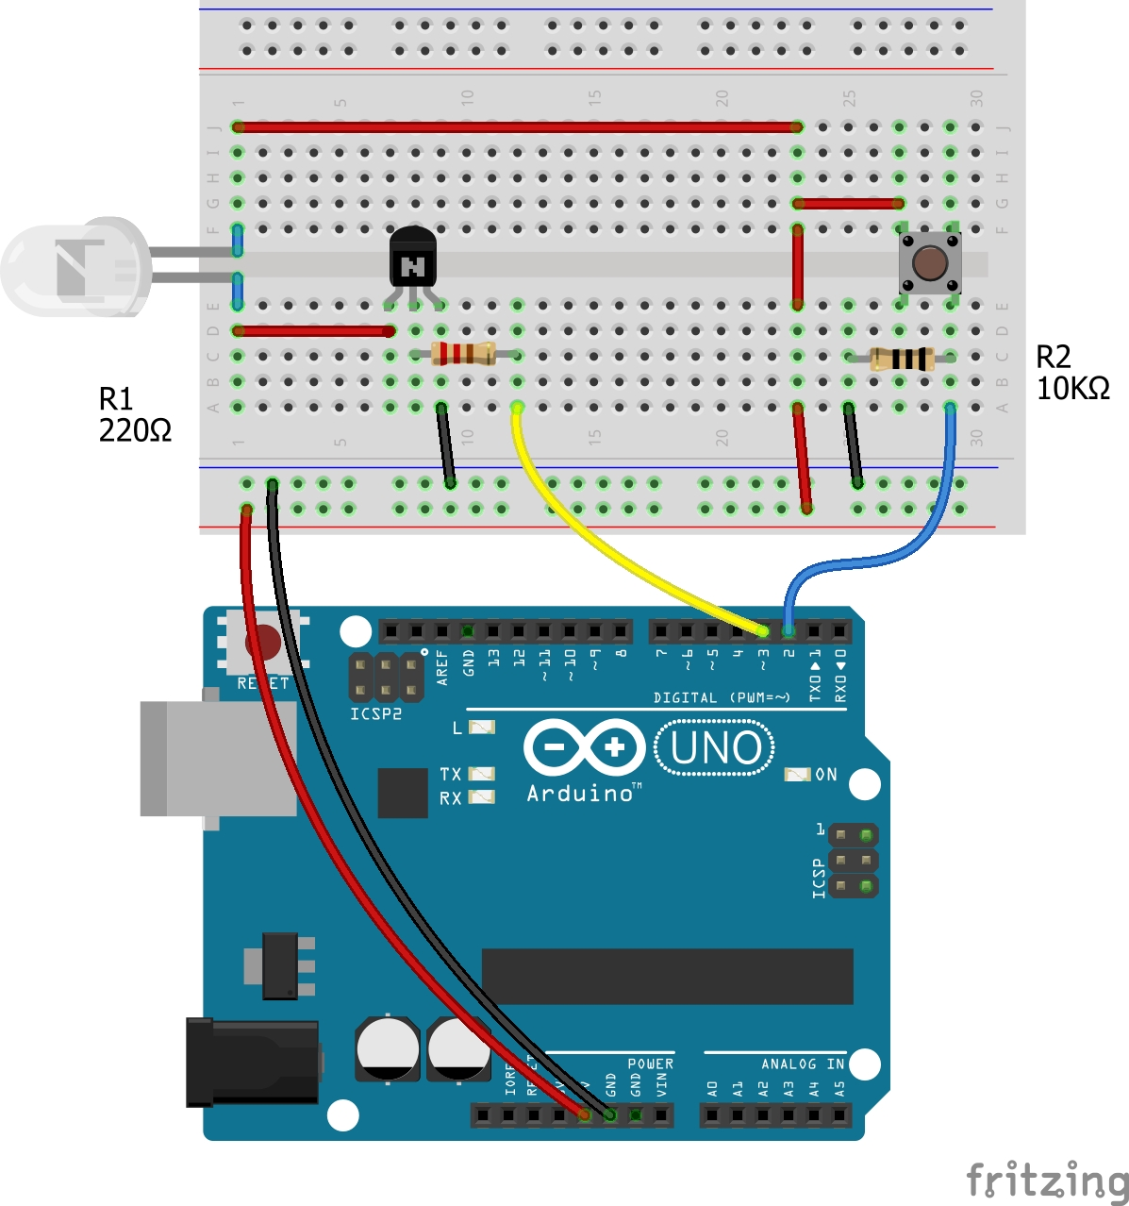
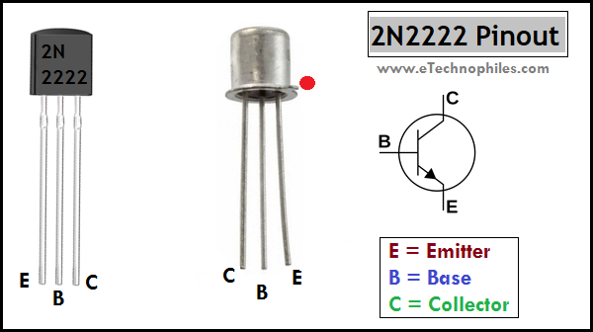
IR Transmit
Power Down the Arduino and build the circuit.

Slide 10
Questions?
In what ways might this be useful?

